Slide 1
PCA

Slide 2
Dimension Reduction-
In pattern recognition, Dimension Reduction is defined as-
-It is a process of converting a data set having vast dimensions into a data set with lesser dimensions.
It ensures that the converted data set conveys similar information concisely.
Example-
Consider the following example-
The following graph shows two dimensions x1 and x2.
x1 represents the measurement of several objects in cm.
x2 represents the measurement of several objects in inches.

Slide 3
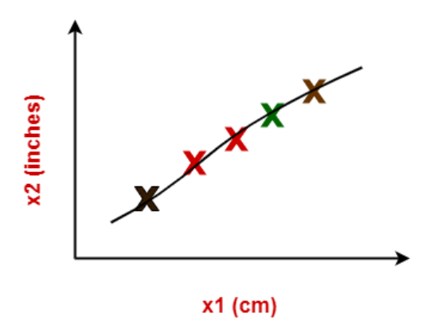
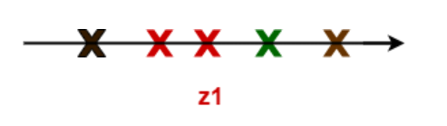
In machine learning,
Using both these dimensions convey similar information.
Also, they introduce a lot of noise in the system.
So, it is better to use just one dimension.
Using dimension reduction techniques-
We convert the dimensions of data from 2 dimensions (x1 and x2) to 1 dimension (z1).
It makes the data relatively easier to explain.

Slide 4
Benefits-
Dimension reduction offers several benefits such as-
It compresses the data and thus reduces the storage space requirements.
It reduces the time required for computation since less dimensions require less computation.
It eliminates the redundant features.
It improves the model performance.
Dimension Reduction Techniques-
The two popular and well-known dimension reduction techniques are-

Slide 5
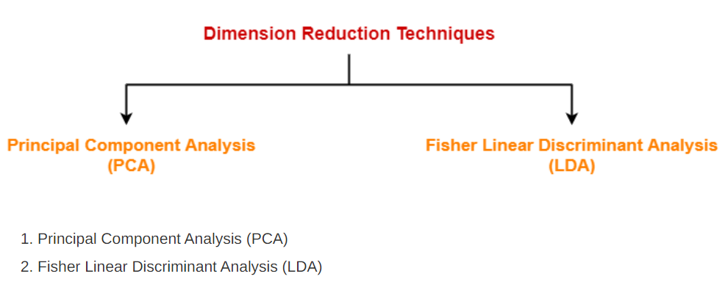
Principal Component Analysis-
Principal Component Analysis is a well-known dimension reduction technique.
It transforms the variables into a new set of variables called as principal components.
These principal components are linear combination of original variables and are orthogonal.
The first principal component accounts for most of the possible variation of original data.
The second principal component does its best to capture the variance in the data.
There can be only two principal components for a two-dimensional data set.

Slide 6
PCA Algorithm-
The steps involved in PCA Algorithm are as follows-
Step-01: Get data.
Step-02: Compute the mean vector (µ).
Step-03: Subtract mean from the given data.
Step-04: Calculate the covariance matrix.
Step-05: Calculate the eigen vectors and eigen values of the covariance matrix.
Step-06: Choosing components and forming a feature vector.
Step-07: Deriving the new data set.

Slide 7
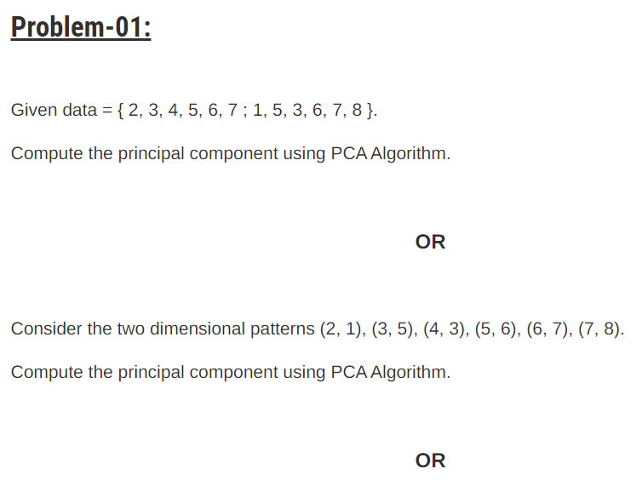
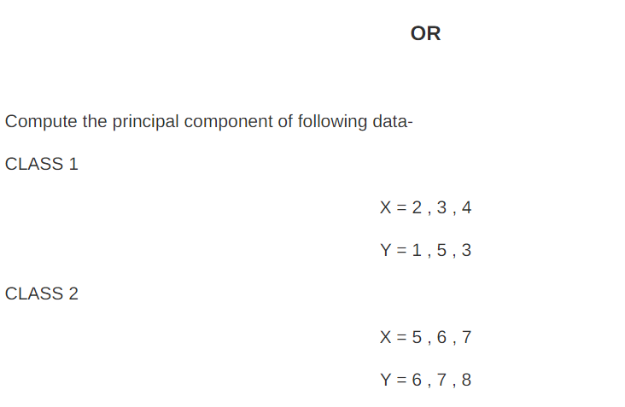

Slide 8
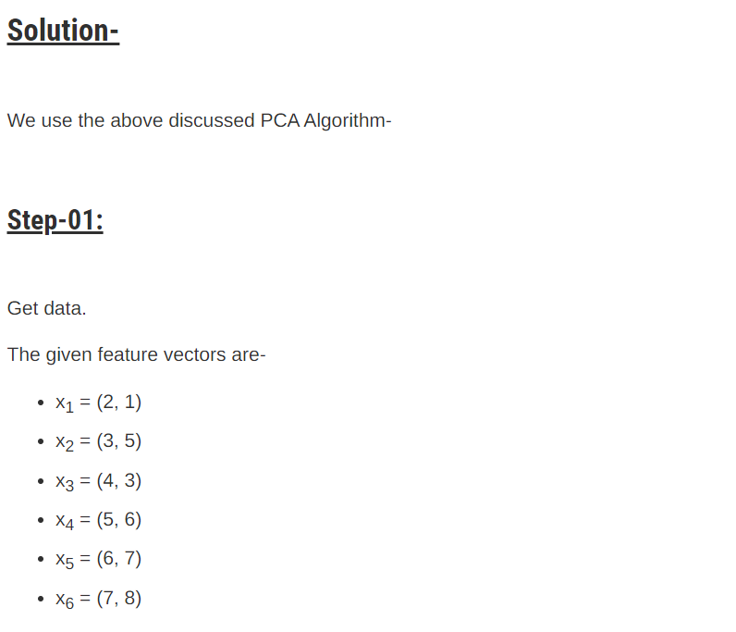
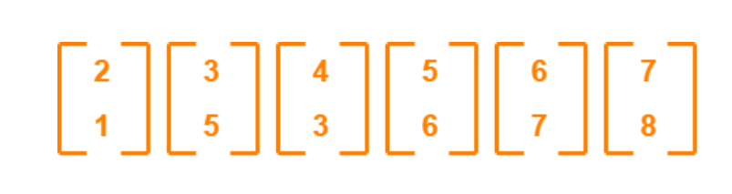

Slide 9
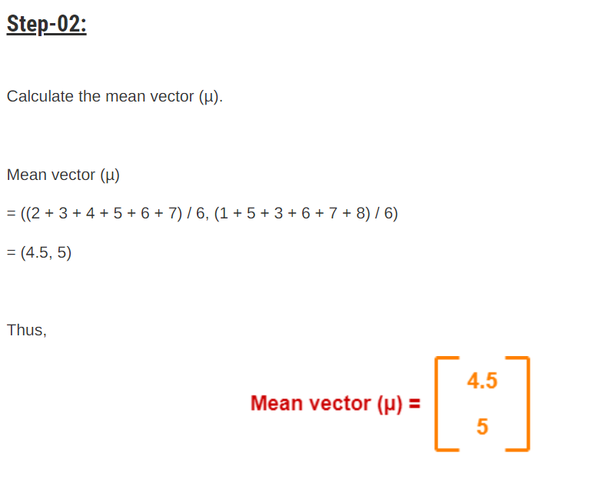
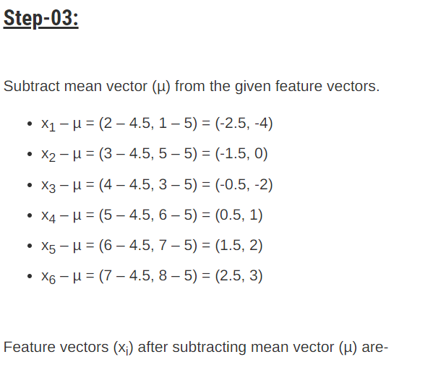
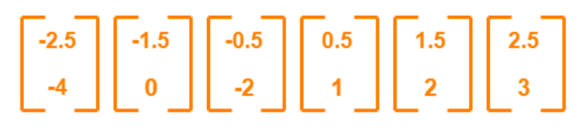

Slide 10
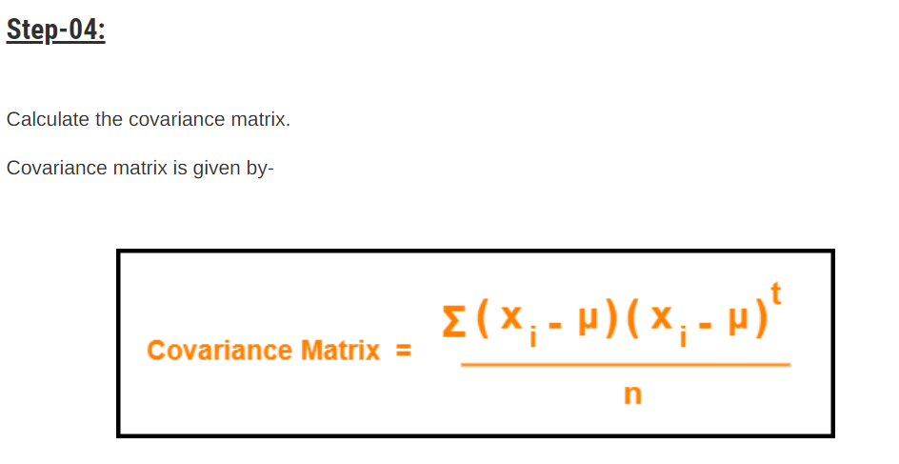
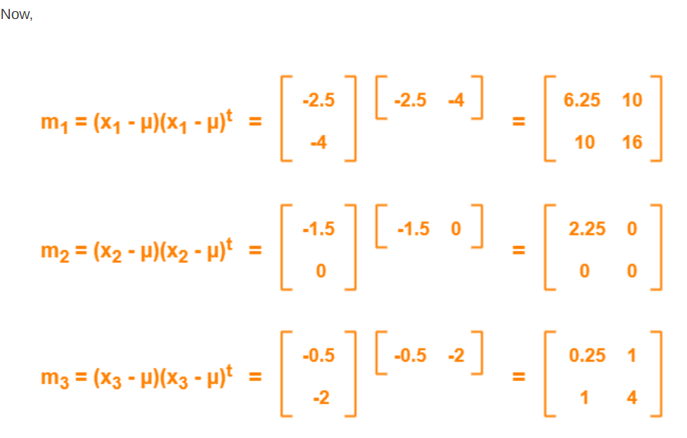

Slide 11
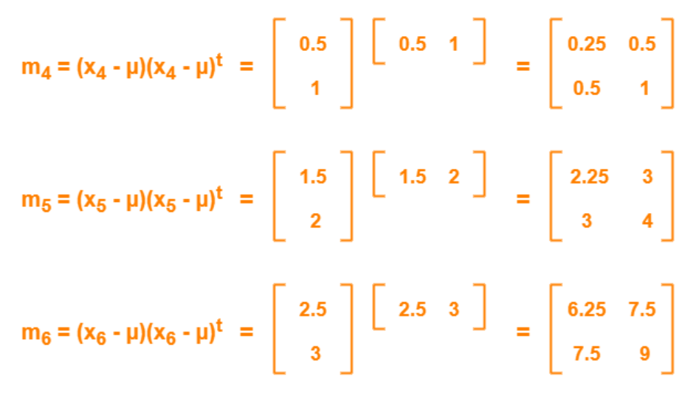
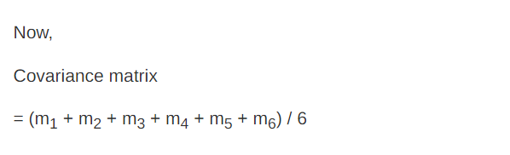

Slide 12
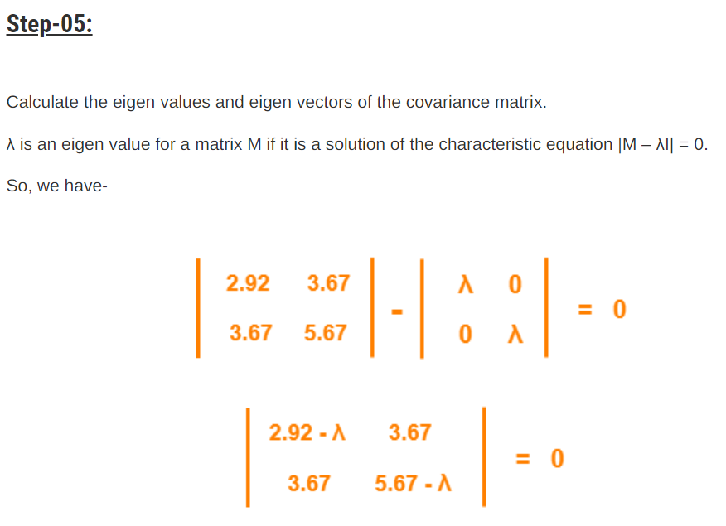
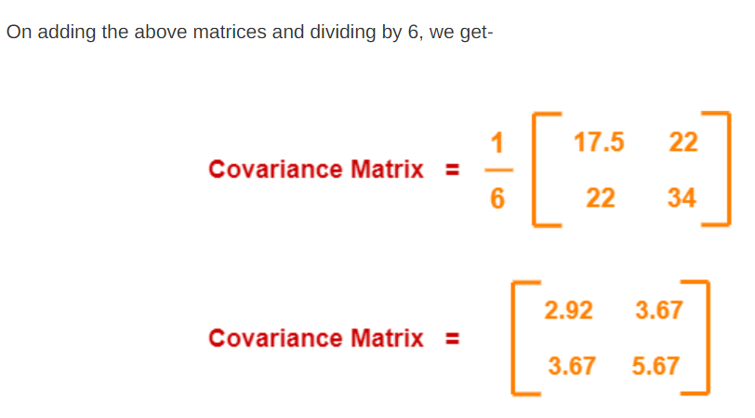

Slide 13
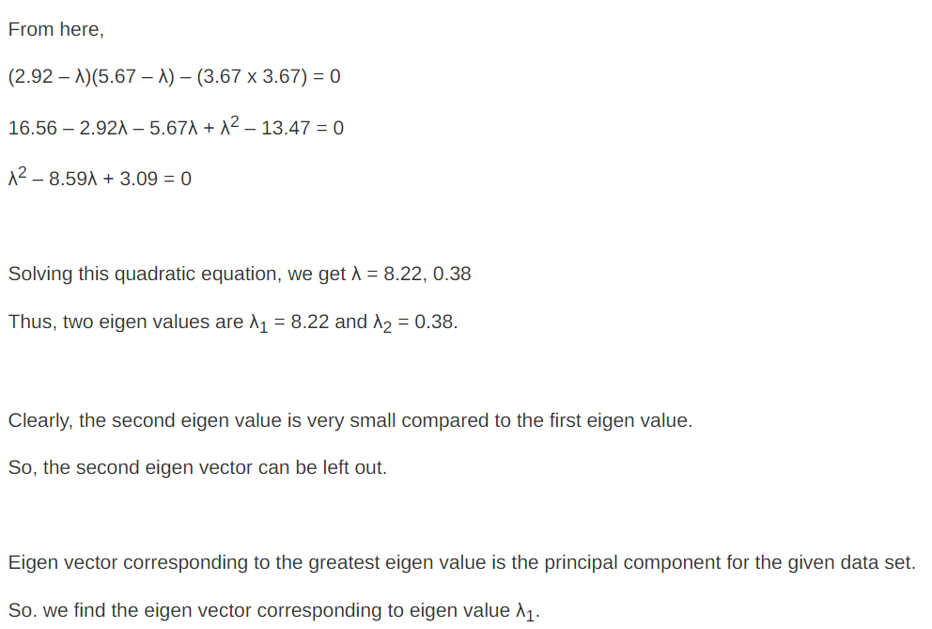

Slide 14
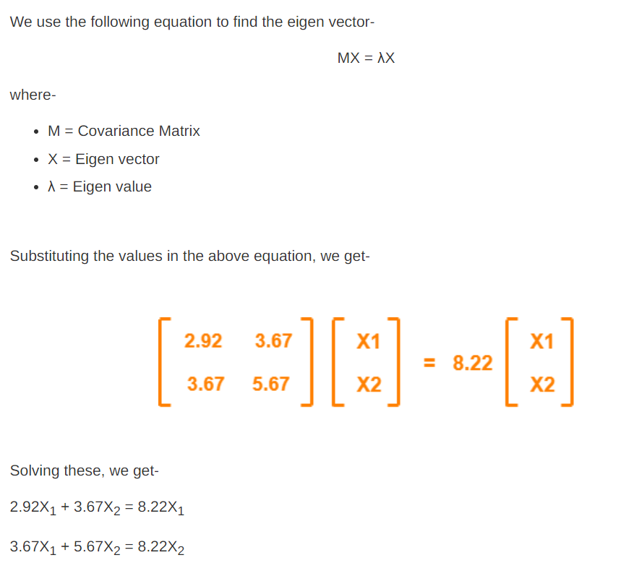

Slide 15
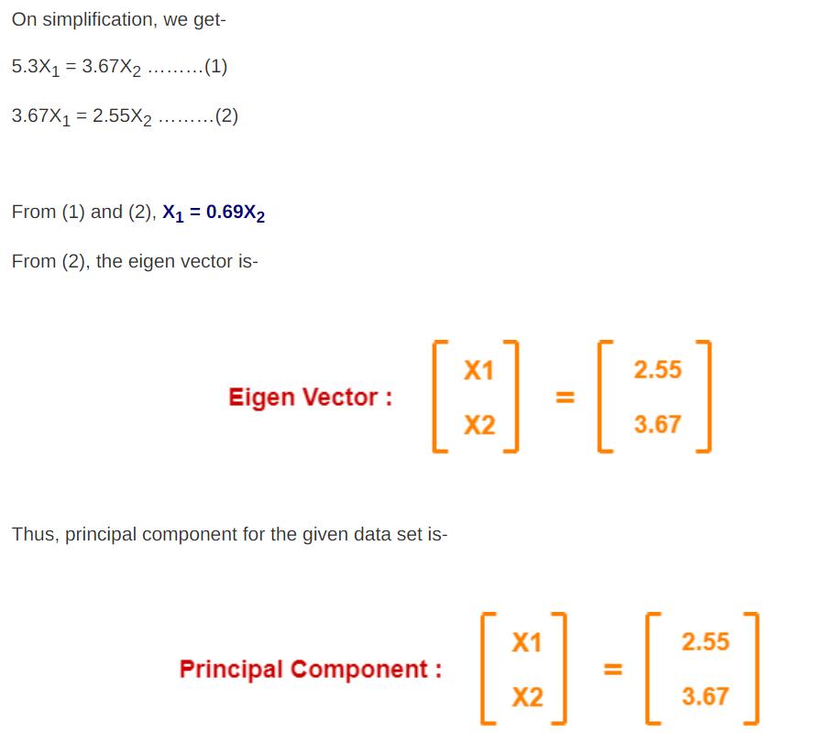

Slide 16
